Slide 1
JIBU - CLV
Khushboo Surana

Slide 2
Industry Overview
Access to clean drinking water remains a significant challenge in Africa
Infrastructure gaps and contaminated water sources
Population growth, climate change, and inadequate sanitation
Efforts to improve access to clean drinking water
Implementation of water purification systems
Borehole drilling
Community-led initiatives for water management and conservation
Efforts by non-profit organizations, government agencies, and international aid organizations to build capacity

Slide 3
About the company
For-profit social enterprise with focus on
Access to affordable and clean drinking water
Promoting economic growth
Enabling local entrepreneurship
Products
Safe drinking water
Liquefied petroleum gas
Fortified porridge
Long term vision
Launch a network of independent franchise owners with high visibility retail storefronts and proven business acumen
Notes:
Goal: Franchise owners high visibility retail storefronts and proven business acumen, are poised to revolutionize the African landscape

Slide 4
About the company
Presence: 8 countries
Number of Franchises: 160
Total Litres Distributed: 490MM
Retail Points: 10,000
Operations - Operates through a franchise model
Expansion - 2 franchises in two countries in 2015 to 200+ businesses across Kenya, Uganda, and Rwanda, with further expansion plans​​

Slide 5
Jibu Ecosystem
Ecosystem:
Jibu, Inc (founding franchisor)
Jibu Area Master Franchisors (AMFs)
Jibu Franchisees
Area Master Franchisor
Investment: USD 250-350K license fee
Role: Launch and grow the Jibu franchise network in their market
Franchise Owner
Investment: USD 5-10K license fee
Supported by Area Master Franchisor
Notes:
Jibu, Inc. (Founding Franchisor)
Jibu, Inc. serves as the founding franchisor, providing the overall vision, business model, and support infrastructure for the franchise network. They oversee the development and expansion of the franchise system.
Jibu Franchisees
Franchisees are individuals or entities that invest in and operate Jibu franchise units within specific territories. They benefit from the established brand, business model, and support provided by both the local franchisor or AMF and Jibu, Inc. Franchise owners typically invest between USD 5-10K as a license fee to operate individual franchise units
Area Master Franchisor (Local Franchisor)
In some cases, there may be an additional layer of franchising represented by the local franchisor or area master franchisor. AMFs are responsible for launching and growing the Jibu franchise network within their designated market areas. This entity supports individual franchisees within their designated territories, working closely with Jibu and other AMFs to facilitate franchise operations. AMFs typically invest between USD 250-350K as a license fee to launch and grow the franchise network in their market.
AMFs play a strategic role in market development and expansion while franchise owners are responsible for day-to-day operations of their individual franchise units. Both AMFs and franchise owners are supported by the broader franchise ecosystem, including Jibu, Inc. and local franchisors, to ensure the success and sustainability of franchise operations.

Slide 6






Competitive Landscape
Notes:
Similar to Jibu, there are other companies which provide safe drinking water in Africa.
Oasis Water, SolarDew, and Openversum share a common goal of providing clean and safe drinking water solutions to communities. They all emphasize innovation, sustainability, and entrepreneurial opportunities in their respective approaches to addressing water purification challenges.
Oasis Water primarily serves the retail and franchise sectors in South Africa, offering refill water services, bottled water, and water dispenser rentals. In contrast, SolarDew focuses on global water scarcity issues, leveraging solar energy for desalination systems. Openversum, based in Europe, specializes in membrane-based water filtration technology and micro-franchise initiatives, targeting a diverse range of markets including households, workplaces, and educational institutions. Each company also employs distinct technological approaches, with Oasis Water emphasizing traditional purification methods, SolarDew focusing on solar-powered solutions, and Openversum utilizing membrane technology for water filtration.
PakVitae, Boon (formerly Swajal), and Nazava Water Filters are distinct players in the water purification industry. PakVitae focuses on providing innovative and cost-effective solutions for global water challenges, leveraging advanced purification technology. Boon specializes in AI-enabled purification systems and monitoring solutions, primarily serving the hospitality, workplace, and educational sectors in India. In contrast, Nazava Water Filters targets low-income households in Indonesia, offering affordable household water purifiers. While PakVitae and Boon emphasize innovation and technology, Nazava Water Filters prioritizes affordability and accessibility for underserved communities.

Slide 7
Data Selection
Meters Reading
Franchise Name
Country
Water produced in liters
Month and year of production
4585 records after cleaning
Health Data
Franchise Name
Country
Hygiene Audit Score
P&Q Audit Score
Full time and Part time Staff
Retailer Satisfaction Score
Retailer Branding Score
Total Sales(converted to USD)
Total Expenses(converted to USD)
1045 records after cleaning

Slide 8
Data Cleaning and Merging
Meters Reading:
Clean names column
Month to 25th date of each month
Data scope is rolling 3 years
Countries: Kenya, Rwanda, Uganda, Goma
Positive water production
Health Data
Clean Franchise Names
Sales and Expenses to USD
Outlier elimination:
Hygiene Audit score
P&Q score
Retailer Satisfaction score
Retailer Branding score
Merged both data based on Franchise ID

Slide 9
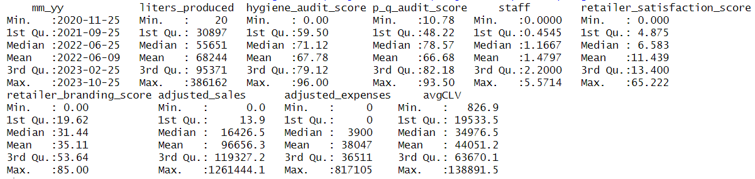
Insights from EDA
Total franchises : 156
The average number of liters produced per month across all franchises is approximately 66,669, with a median of 53,823 liters. High variation with minimum production as low as 20 liters and maximum production as high as 386,162 liters.
Adjusted expenses range from 0 to $817,105, with a median value of $3,900 and a mean value of $38,047, indicating significant variability in expenditure levels across franchises

Slide 10
Insights from EDA
Retailer satisfaction scores range from 0 to 65.222, with a median score of 6.583 and a mean score of 11.439, indicating a generally positive satisfaction level among retailers
Retailer branding scores vary from 0 to 85.00, with a median score of 31.44 and a mean score of 35.11, suggesting a moderate to high level of branding effectiveness

Slide 11
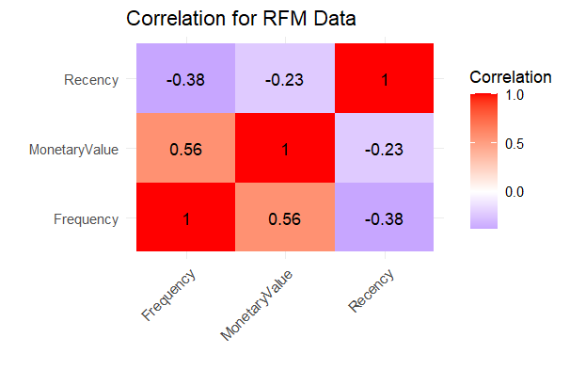
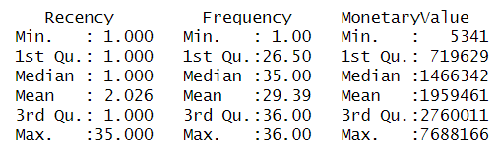
Insights from EDA
Recent Engagements: Median recency at 1 shows prevalent recent activity, with a mean of 2.026 indicating consistent engagement
Production Regularity: Median frequency at 35 and a mean of 29.39 reflect high and steady production rates
Monetary & Frequency Link: A correlation coefficient of 0.56 indicates a strong positive connection between production frequency and monetary gain

Slide 12
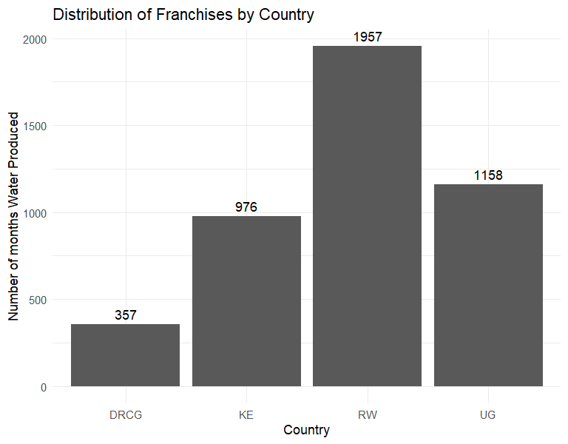
Insights from EDA
Frequency of water produced is highest in Rwanda contributing 44% of total production followed by Uganda contributing 26%

Slide 13
RFM Transformation
The data is grouped by franchise_id, calculating Recency as the temporal difference between the latest date and the present, expressed in months, while Frequency represents the production count and Monetary Value is the total liters produced
Month_Year —-----> Recency
Water production count —-----> Frequency = n(),
Water Produced —-----> MonetaryValue

Slide 14
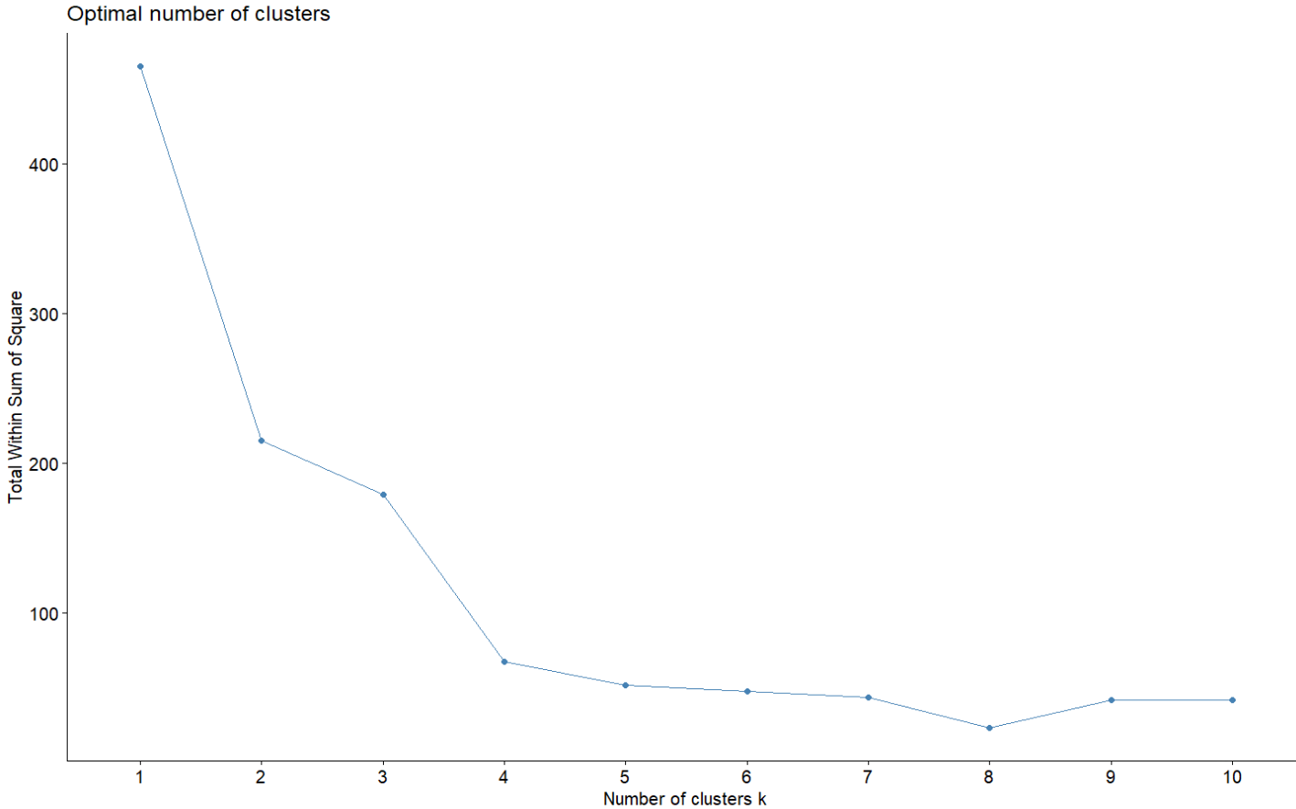
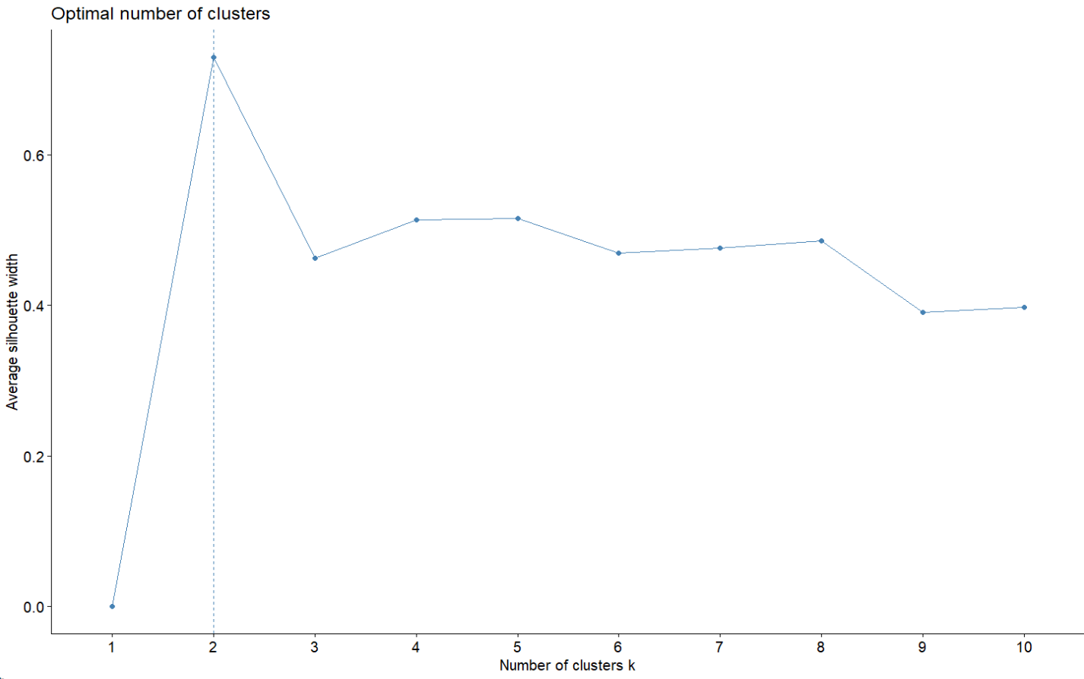
Customer Clustering
Customer Clustering: K-means clustering segments customers into 8 clusters explains about 95% based on RFM data. It assigns franchises to clusters with similar RFM profiles, revealing distinctive attributes through computation of cluster centers

Slide 15
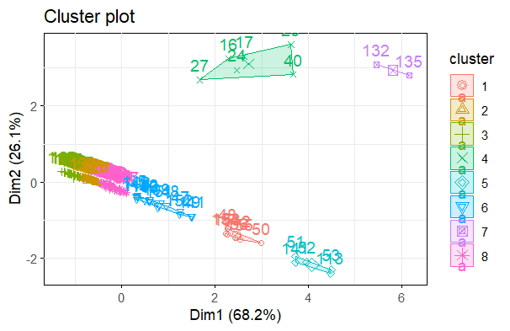
Final Clusters

Slide 16
CLV Calculations
mydata2$CLV <- mydata2$liters_produced / ((1 + mydata2$USInterestRate) ^ mydata2 $MonthPresent)
The mydata2$CLV calculation adjusts the liters_produced by the present value, applying the USInterestRate over the period defined by MonthPresent to determine the customer lifetime value
mydata2$liters_produced: Represents the quantity of water (in liters) produced by the franchise
mydata2$USInterestRate: The applicable interest rate for the time period associated with the production
mydata2$MonthPresent: The number of months since the start date, indicating the time period

Slide 17
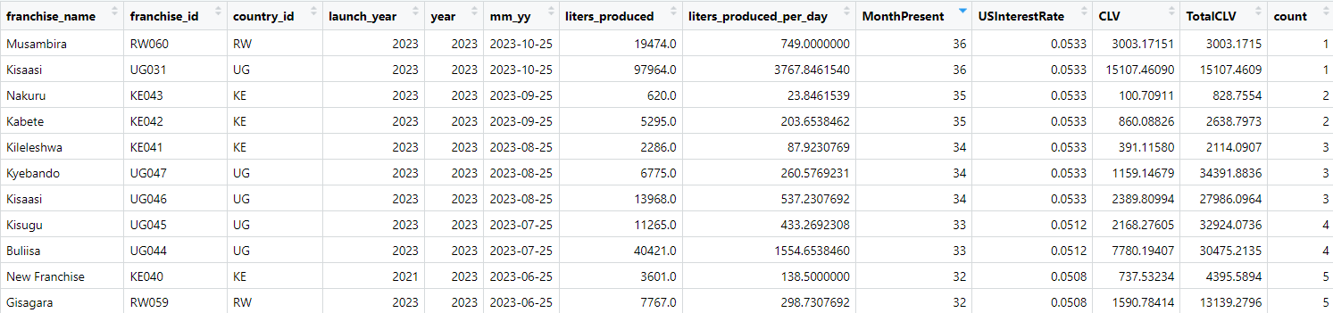
CLV Calculations
Compute CLV: Calculate the customer lifetime value for each entry using the interest rates and the number of months present
Aggregate CLV by Franchise: Group mydata2 by franchise_id and sum the CLV for each franchise
Merge CLV Totals: Join the aggregated CLV totals back to mydata2 to include Total CLV per franchise

Slide 18
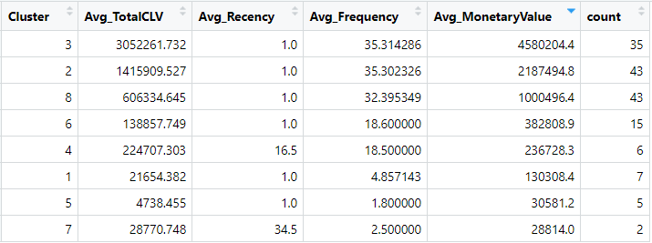
CLV Summary by Clusters
Clusters with higher average Total CLV (like 2, 3, and 8) are very valuable and consist of franchises with high sales volume, repeat purchases over short periods. 77% of franchises are in this cluster
Clusters with lower counts (like 4, 6, and 7) could be niche franchises or new ones that haven't had the time to build up their customer base or sales volume
Clusters with lower Total CLV (like 1, 5, and 7) might need strategies to boost their sales

Slide 19
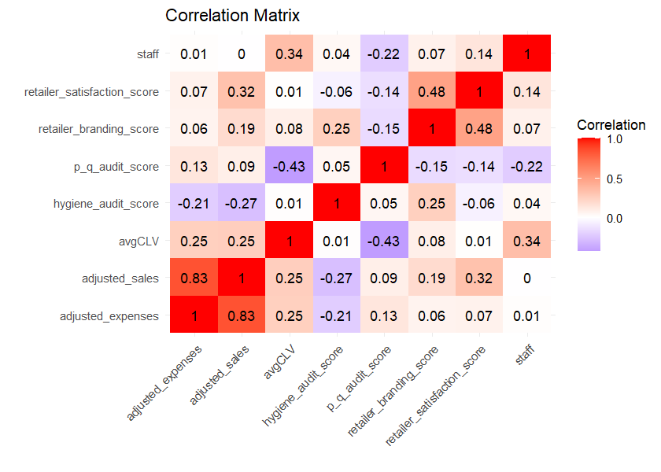
Drivers of CLV
Key predictors of CLV: Number of staff and product quality audit score, which directly impact customer satisfaction and loyalty.
There also seems to be a high impact of Retailer Satisfaction Score along with some impact of Hygiene Audit Score.
Retailer Satisfaction Score has a high correlation with Adjusted Sales for the Franchise
Model explains 85% of the variance in CLV

Slide 20
Conclusion and Recommendations
Understanding Dual Customer Relationships: Jibu operates within a unique framework, serving franchise owners and end-users, necessitating attention to both customer segments for sustained growth
Operational Focus on Product Quality and Customer Service: Benefits both franchise owners and end-users, enhancing loyalty and profitability for high and low CLV franchises
Strategic Marketing Initiatives: Tailored marketing campaigns emphasizing product quality and brand reputation drive long-term value by attracting and retaining both franchise owners and end-users
Continuous Monitoring and Adaptation: Enables Jibu to adapt to market dynamics, benefiting both high and low CLV franchises by identifying growth opportunities and refining strategies
Investment in Franchisee Relationships:Investing in franchisee relationships enhances operational efficiency and end-user satisfaction and fosters growth for both high and low CLV franchises

Slide 21
Thank you

